Slide 1




Speller Metcalfe
Construction
Notes:
Introduce myself and Buzz and say here to talk to you about keeping yourselves safe whilst we are building the new part of your school

Slide 2

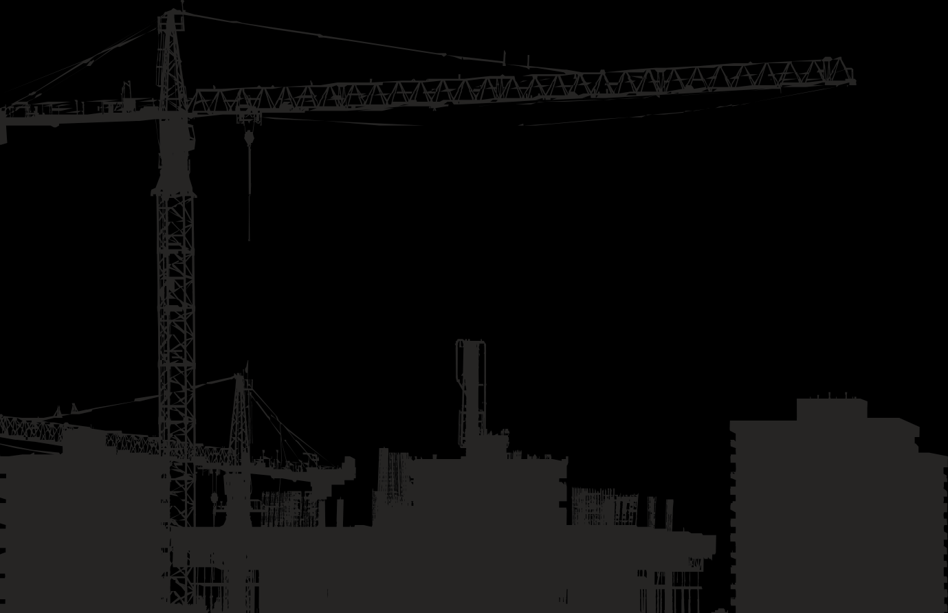
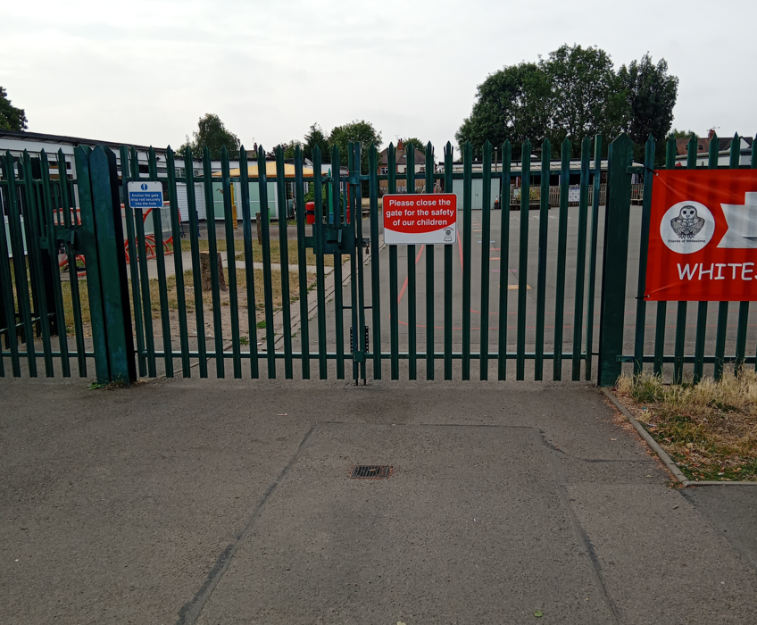
Your School before…
Notes:
Who remembers your school like this before the construction work started?

Slide 3

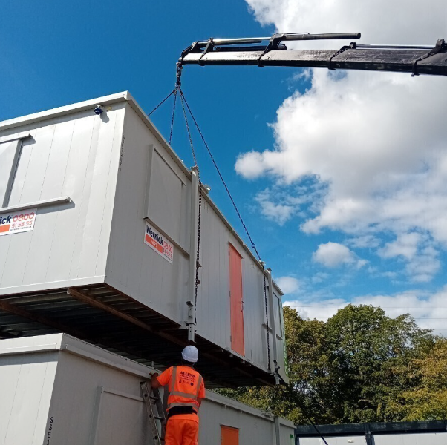
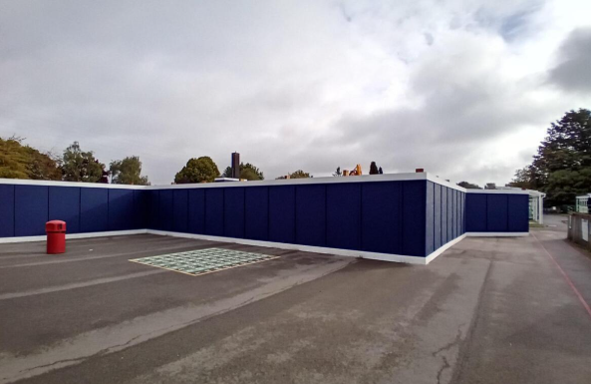
Changes so far…
Notes:
Changes to your routine and the way your school looks. You will find lots of people doing lots of different jobs to build new areas for you.

Slide 4
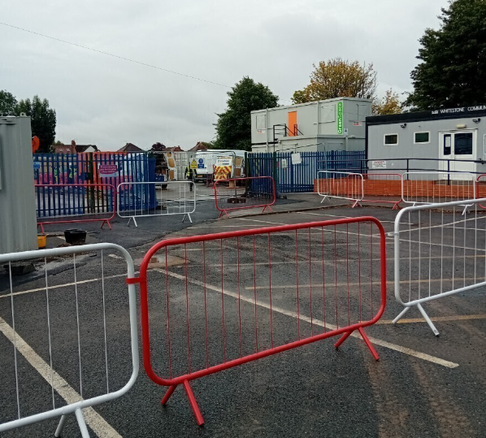
Your school now…
Notes:
This is how it looks most recently,

Slide 5
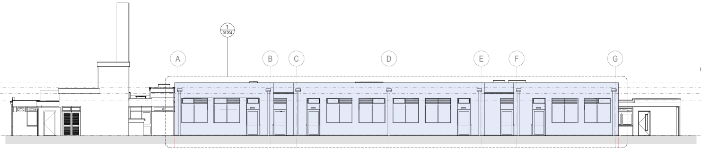
Your finished school…
Notes:
As we haven’t finished your school yet we don’t have any more pictures but these are drawings done by design managers and architects showing what the end building will be shaped and structured like.

Slide 6

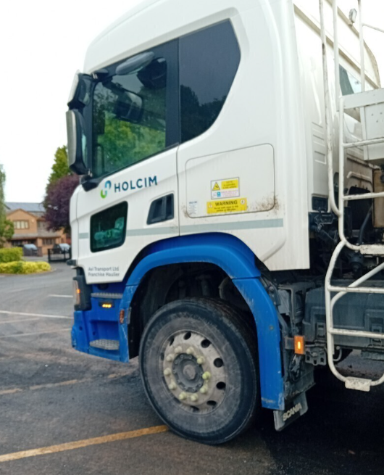
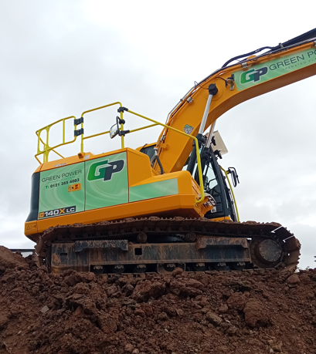
Hazards on and near Construction Sites
Large Machinery
Uneven Ground
Large Vehicles
Noise
Tools
Dust
    Roof Works/Works at Height
Notes:
With all those machine and building materials and vehicles, how do you think we keep safe?
Refer to Buzz and me and what I’m wearing.
Get children up to try on items.

Slide 7
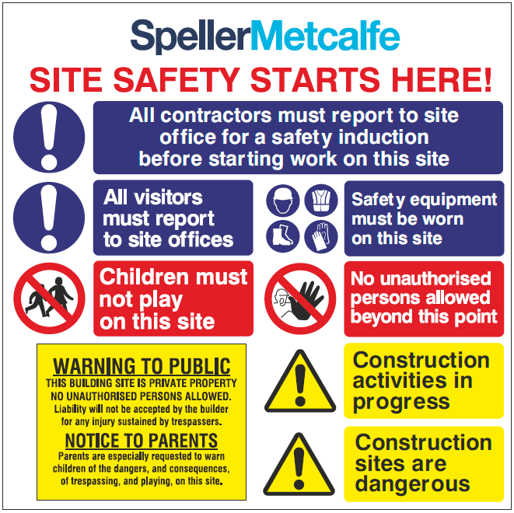
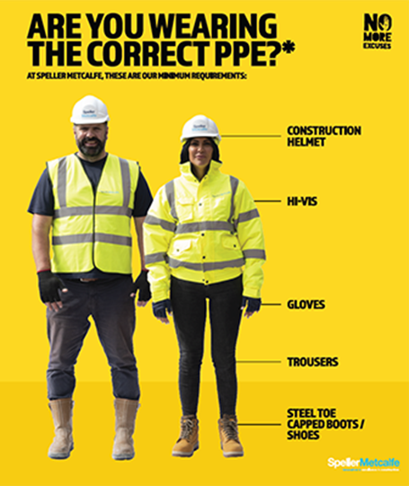
Staying safe on and near Construction Sites
Safety Clothing:
  Helmet
  Gloves
  High Viz
  Safety Boots
  Masks, Safety Glasses and Ear Protection
  Training
  Adhering to Rules
  Staying alert!
Notes:
With all those machine and building materials and vehicles, how do you think we keep safe?
Refer to Buzz and me and what I’m wearing.
Get children up to try on items.

Slide 8

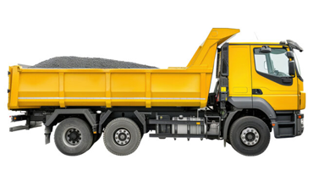
What can you do to keep yourselves safe whilst Construction is happening?
Do not enter the construction site area without permission.
Be aware of large moving vehicles and machinery on the site and roads around school.
STOP! LOOK! LISTEN!

Slide 9
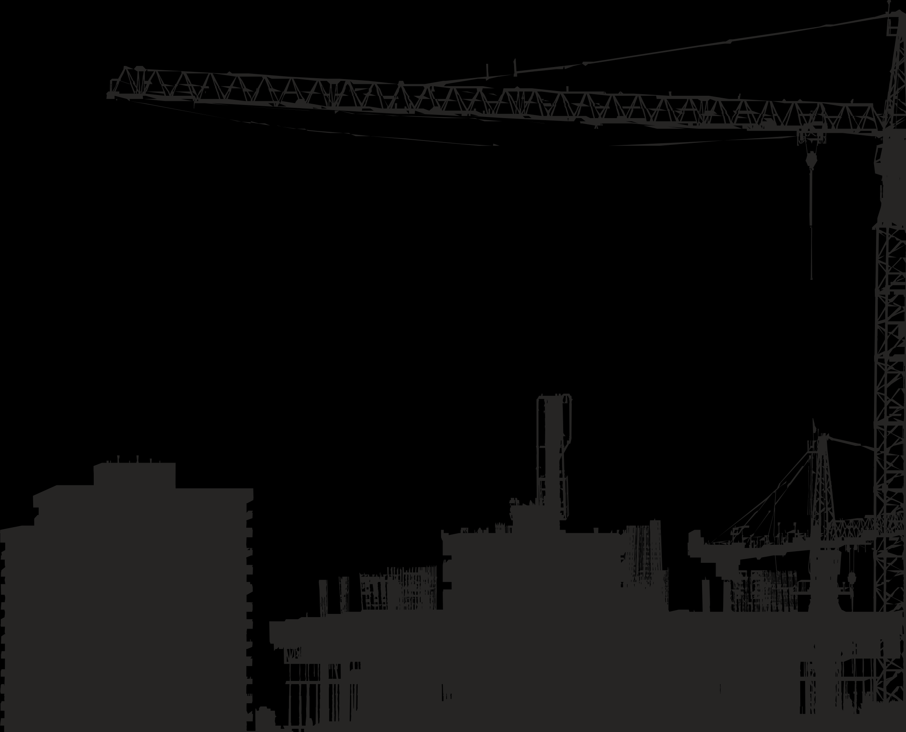


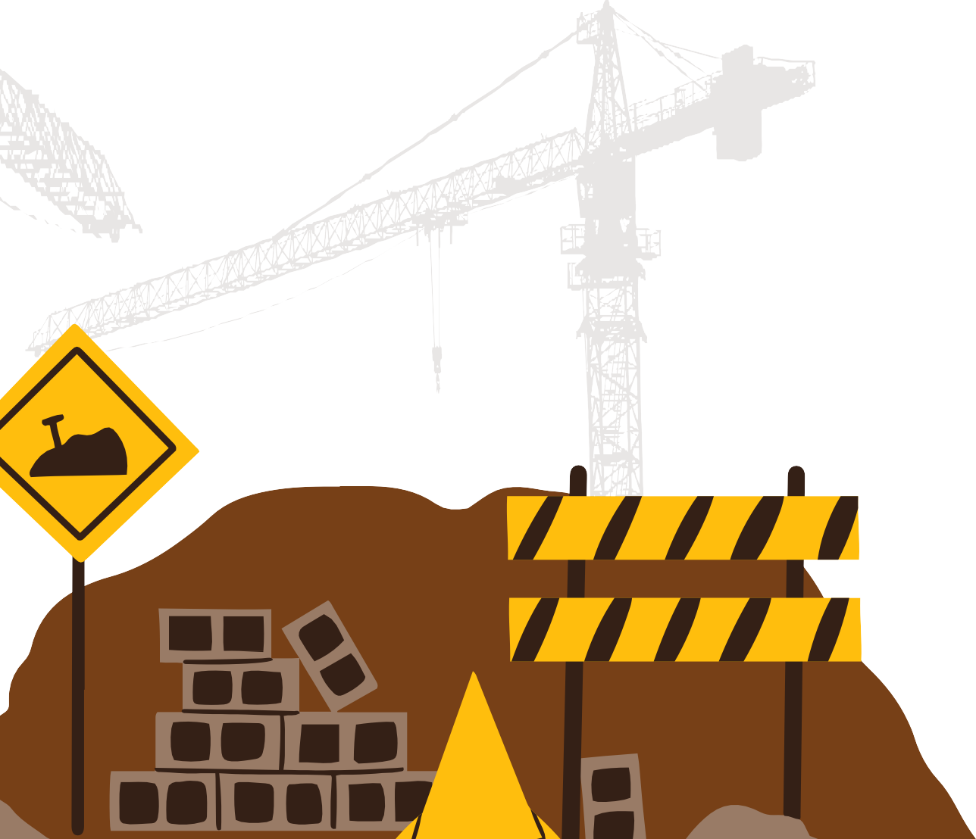
Thank You
Notes:
Any body have any questions?

