Slide 1











Welcome to Whitestone’s

Slide 2
Aims of today’s session?
To explain phonic terminology.
To share information about the Phonics Screening Check.
To share ideas for support at home.
To answer any questions that you may have.
Notes:
Phonics is really important in the first stages of reading

Slide 3
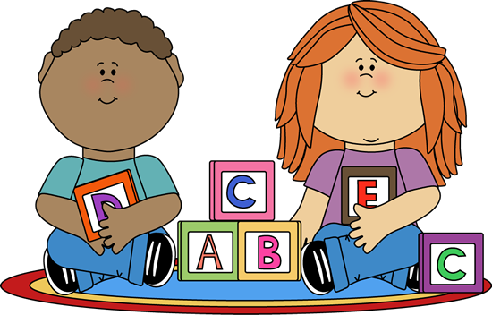
Terminology
Phoneme:
The smallest unit of sound in a word.
There are 44 phonemes in the English language.
Grapheme:
The letters or groups of letters that represent a phoneme.
Notes:
Pure sounds

Slide 4
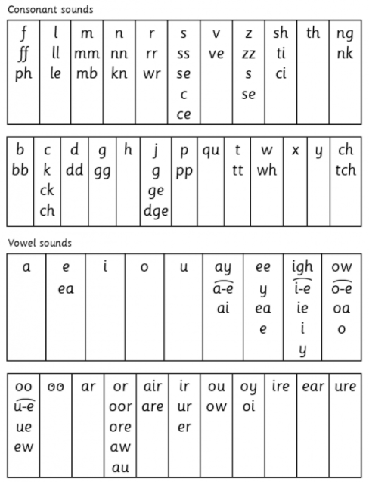
Some phonemes are represented by different letters. These are called graphemes.
Each column shows a different phoneme.
Notes:
Pure sounds - video

Slide 5
Digraph:
Two letters that make one sound. For example: sh, ai and ow.
Trigraph
Three letters that make one sound.
For example: igh, tch, dge

Slide 6
SPLIT DIGRAPHS
2 letters, making one sound, that are split between another letter.
There are 5: a-e e-e i-e o-e u-e
Children need to be taught to recognise these within words so that they don’t say the single letter sounds
Examples: cake, like, phone

Slide 7
SEGMENT (Fred talk):
We segment words into phonemes to read.
Split it this way also helps children to spell.
For example: sh – ee – p = sheep
BLEND (Read the word):
We blend by putting all of the phonemes we have heard or the graphemes we have read together.
For example: paint = p – ai – n - t
Notes:
Sound buttons

Slide 8
ALTERNATIVE PRONUNCIATIONS:
A grapheme can be pronounced in different ways. For example:
i - fin, find ow - cow, blow
o - hot, cold ie - tie, field
c - cat, city ea - eat, bread
u - but, put a - hat, what
ch - chin, school, chef
ou - out, shoulder, could, you

Slide 9

How do we teach all of this?
At Whitestone we use RWI to teach phonics.
We do this through a 10/15 minute ‘Speed Sound’ lesson at the beginning of every RWI session.

Slide 10

What does a typical Phonics
lesson look like?
Say the sound
Read the sound
Review the sound
Read the words
Review words
Alien words
Spell the words

Slide 11
Any Questions?

Slide 12


Slide 13
Phonics Screening Check
Every Year 1 child in the country will be taking a phonics screening check in the same week: week beginning 6th June.
It is very similar to tasks the children already complete during RWI lessons.
The focus of the check is to check children’s segmenting and blending skills; not to test their vocabulary.
It has been designed so children of all abilities will be able to take part and there are a few practise words to warm them up to ensure they understand what to do!

Slide 14
What will the children do?
It will take roughly 10 minutes to complete.
They will be asked to ‘sound out’ a word and blend the sounds together. e.g. d-o-g – dog.
The check will consist of 40 words; 20 real words and 20 nonsense words (we call these “alien” words). These are words that are phonetically decodable but not actual words with a meaning e.g. brip, snorbling to check a child can decode using phonics skills and not their memory.
‘Alien’ words have a corresponding alien image.

Slide 15
A few examples of words

Slide 17
Tricky Areas
Trying to “make sense” of alien words
For example stribe may be read as stripe
Chunking/compound words (pumpkin /lunchbox/sunshine)
Confusion between phonemes and their corresponding letter names (e E) e.g.men
Recognising digraphs/trigraphs within words, especially split digraphs, au, aw and ue
Trying the “alternatives” out especially for vowels
(human, giant, circus) – we tell the children to tweak a word or make it make sense.

Slide 18

How will it be administered?
Your child’s class teacher will conduct the test with each child in the class.
The children will complete the check on a one to one basis in a quiet area of the school.
We are not allowed to indicate to the children at the time whether they have correctly sounded out and / or blended the word BUT they will be praised whatever their attempts are!
Notes:
Take into consideration dialect/accent grass and also speech and language needs.
Show video

Slide 19
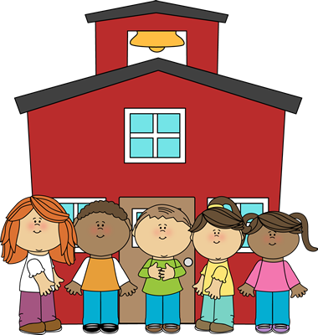
The results…
The pass rate is yet to be determined by DfE but for the last few years it has been 32/40.
We will inform you in your child’s report whether they fall below or within this standard.
If they do not pass they will retake
the screen in Year 2.

Slide 20
Any Questions?

Slide 21
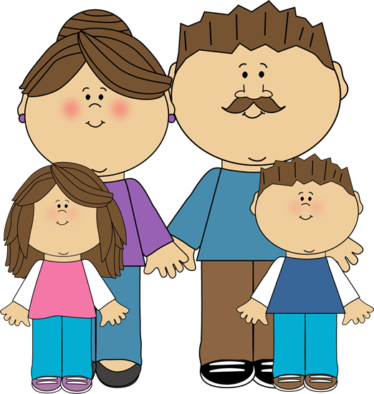
How can you help at home?
Read at least 3 times a week. If you can do more even better!
Read the books we send home especially RWI books.
Make sure your child attends school.

Slide 22
How can you help at home?
Make reading fun – play games.
Complete home learning!
Be a good role model.
Notes:
Videos
Spot sounds in the environment, do sound hunts around the house, hide sounds to make a word.

Slide 23
Any Questions?

Slide 24

Finally…
PLEASE REMEMBER: Phonics is not the only strategy and the only way you become a good reader. It’s important to remember that phonics is the step up to word recognition but not for all children. Automatic reading of all words is the ultimate goal. If your child
does not pass it doesn’t mean
they’re not a good reader. Continue
to read with your child and encourage
them to:
Enjoy reading!

Slide 25
Any Questions?

