Slide 1

Keeping Safe:
Stop, Think, before you Click!
8 rules for responsible ICT use
Notes:
Has anyone seen this sign around school?
Where would it be sensible to find them?
Why is it important to have rules when using ICT/computers/internet?
Through the year we are going to be thinking about each of the 12 rules and why they are so important

Slide 2




Rule 1
Only use the schools computers for school work and homework.
Notes:
What other things could you possibly use the computers for?
Shopping
Talking to friends
Using the internet
Playing games
Why do we just use them for school work?
Would you have a chat and play games with friends in the middle of a maths lesson?
Children sat talking and playing with a bat and ball

Slide 3


Rule 2
Only delete your own files.
Notes:
Why would you perhaps need to delete your own files or work?
Why must you never delete someone else's work on the computer?
Would you rub out or tare up someone's work in a science lesson?
Two children tearing pages out of a topic book

Slide 4
Rule 3
Don’t look at other peoples files
without their permission.
Notes:
What does permission mean?
Name some things we give permission for? – have our photo taken, when we go on a trip out of school, when people play our games.
We should do the same with work on the computer, esoecially when logged on as your partner in the ICT suite.
Would you open someones literacy book and read through their work without their permission?
Children with work books, someone takes someone elses and starts reading it – thats mine, I didnt give my permission!

Slide 5
Rule 4
I will only use my log in details or the class log in details.
Notes:
Who can remember their own username and password?
Why is it important to keep these safe and private?
All of the work you do on the computers in school is kept in safe folders on the computers and belong to the person who created them.
If you log in as someone else because you cant remember your own password then all of your hard work will be saved in the wrong place!
When your teacher takes the register would you put your hand up and answer for your friend?

Slide 6

Rule 5
I will not bring files into school without permission.
Notes:
3 children each with a picture of what they would like to bring into school
Pet snake
Pet horse
Baby brother
Would you bring these things into school? Why?
The rules are the same on the computers, we cannot bring computer files into school on the school computers in case it brings a virus or damages the school computers. If you have something to show which you have made on the computers then ask your teachers permission first!

Slide 7


Rule 6
I will ask permission from a member of staff before using the Internet and will not visit Internet sites I know to be banned by the school.
Notes:
When your teacher has given you some free time to use the computers and the internet can we just visit any site on the internet?
Why?
Do we bring our own game boys and electronic games to play with during golden time? Why?
Which sites are safe for you to visit on the internet?

Slide 8
Rule 7
The messages I send, or information I upload, will always be polite and sensible.
Notes:
When we do talk to people we know, do we say nasty or unkind things to them? Why?
What happens if we do?
So when we send emails to other people is it ok to be mean and unkind?
When we send emails, everything is recorded and can be found at a later date. So if we do send something which is unkind, it will be found out.

Slide 9
Rule 8
I will not give my home address, phone number, send a photograph or video, or give any other personal information that could be used to identify me, my family or my friends, unless my teacher has given permission.
Notes:
Children showing and holding up pieces of paper with their information on – full name, school, age, home address....
Would you go up to someone in the street and tell them about yourselves? why?
So we shouldnt share this information with someone via the internet.

Slide 10
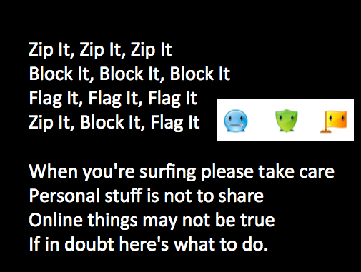
Notes:
Lets finish with our Safety Song... Who can do the actions!?
Final assembly 4th June...... Share the final of the 12 rules but also the sanctions.
Possibly share with the parents the 12 rules once again, the fact that they have been discussed and also the sanctions.

